Slide 1
Introduction to Object Oriented Programming
Ahmad Fauzi

Slide 2
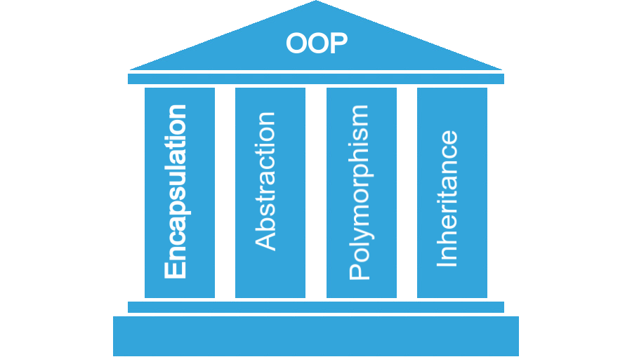
Pillars of OOP
https://krishnkant-1si16ec037.medium.com/object-oriented-programming-for-beginners-63ce9581e4ca

Slide 3
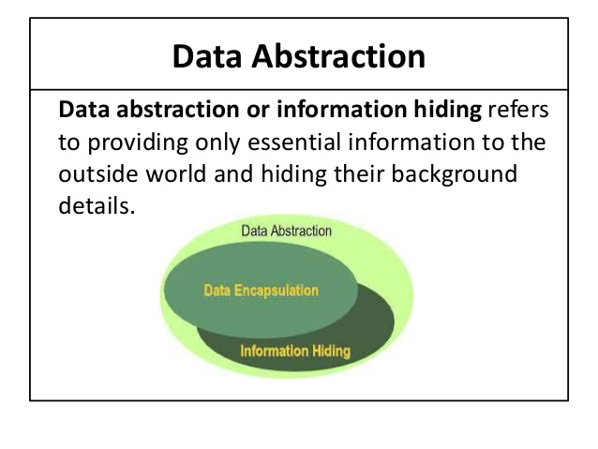
Abstraction
The child class method must be defined with the same name and it redeclares the parent abstract method
Source Image: https://github.com/shiddiqeuy/Java-Abstraction

Slide 4
F(x) f(x,y)

Slide 5
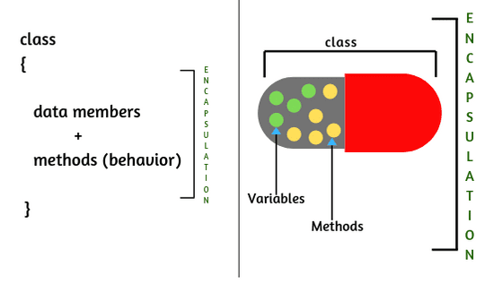
Encapsulation

Slide 6
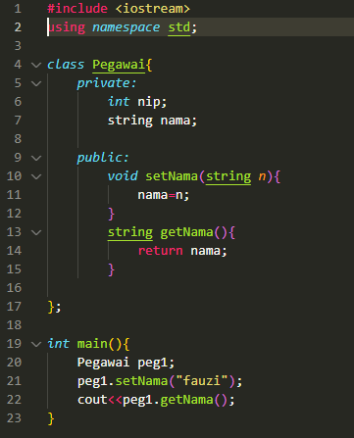
Example’s Code
Modifier:
(+) public
(-) Private
(#) protected
MODIFIER
Method Setter and Getter

Slide 7
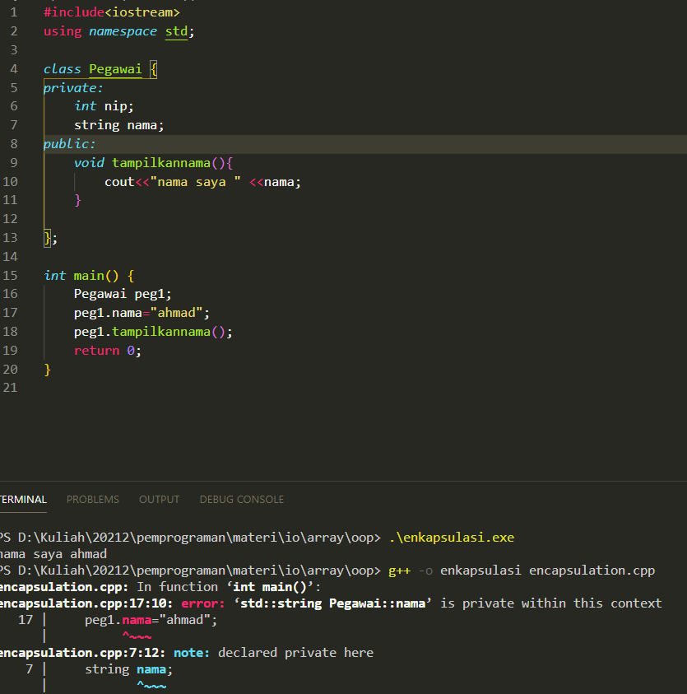
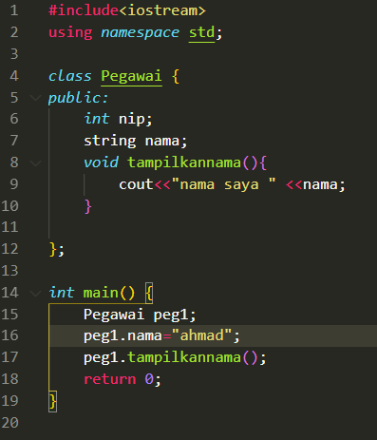

Slide 8
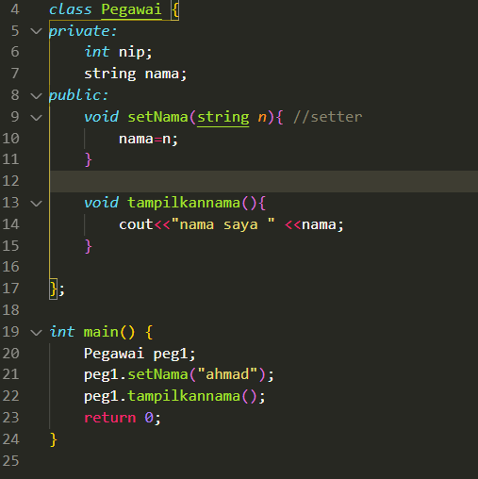

Slide 9
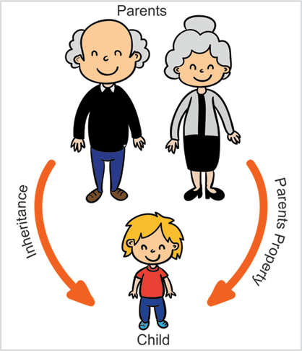
Inheritance

Slide 10
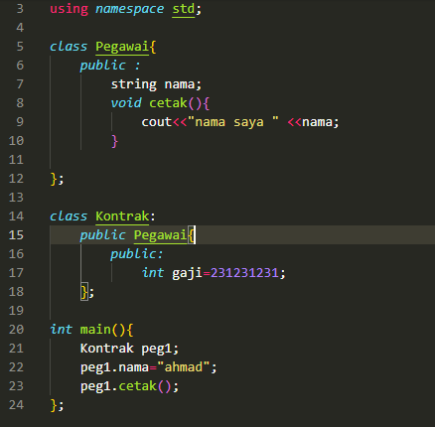
Example’s Code
Parent Class
Child Class

Slide 11
Polymorph
We can say that polymorphism has means “Many forms”.
We know the term:
Overloading ~ one function but has many tasks
Overriding ~ give a new definition to parent class in child class

Slide 12
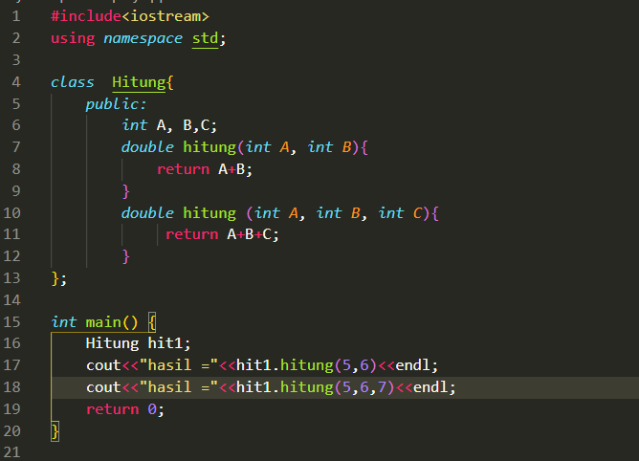
Example’s Code
Overloading

Slide 13
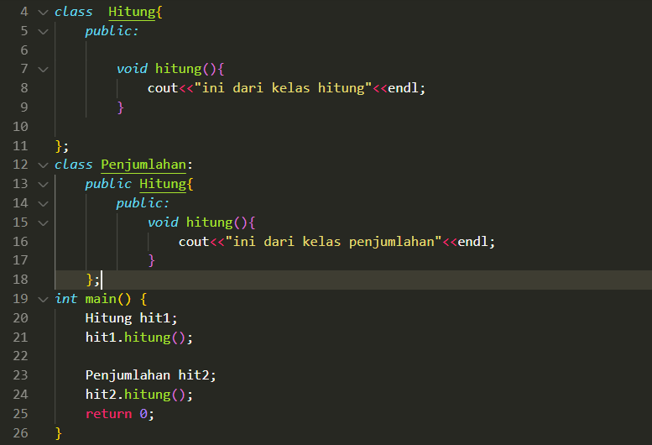
Next…
Overriding

